Slide 1

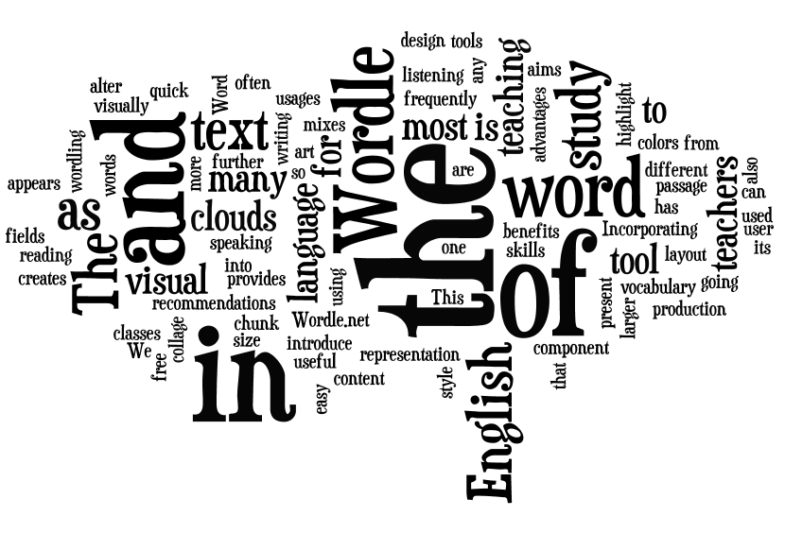
Terms and Definitions
Corpus
Collection of domain-specific documents.
Document
Variable length piece of text containing several tokens.
Token / Word
A sequence of symbols that follows a certain rule.

Slide 2
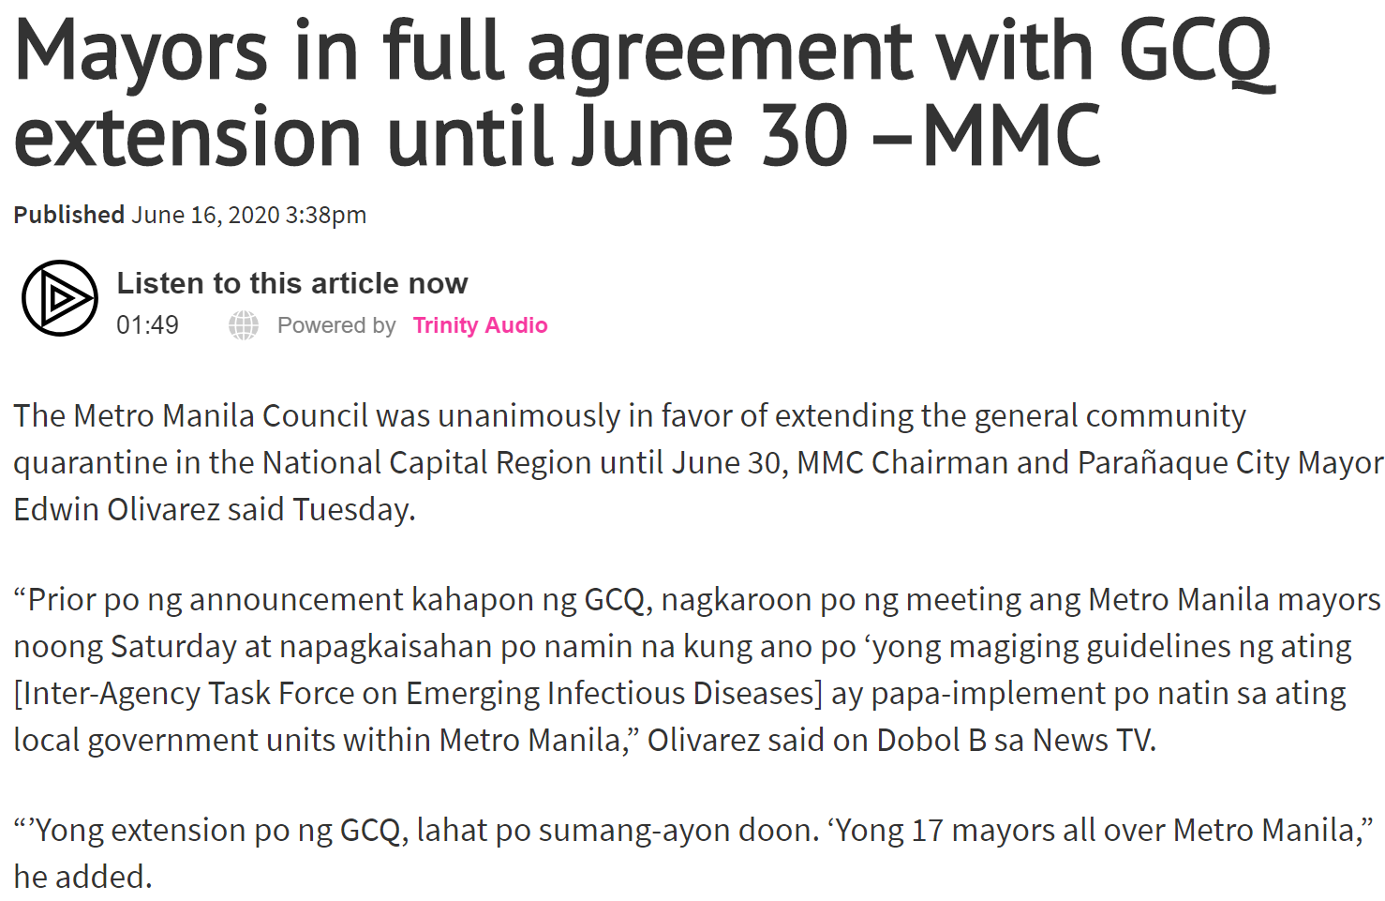

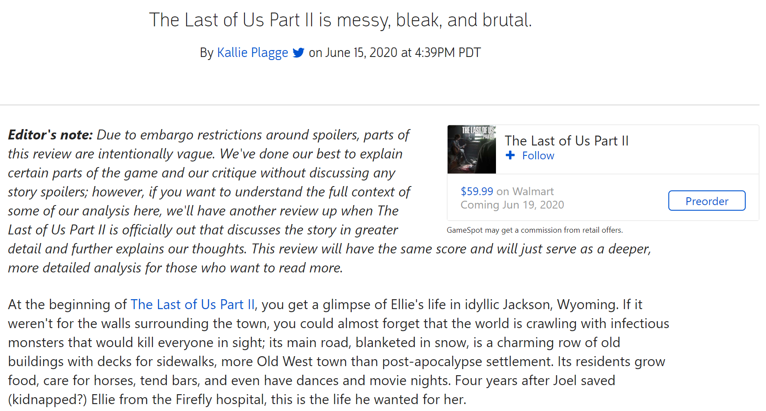

Slide 3
Basic Text Pre-processing
By: Nigel Silva

Slide 4
The Basic Pipeline
Segmentation
Tokenization
Case Folding
Stemming or
Lemmatization

Slide 5
Segmentation

Slide 6
Segmentation
Segment the text per sentence
(maybe even per paragraph).
“?”, “!” are good sentence separators
“.” more ambiguous (abbreviations, or trailing periods “…”)
Also possible to segment text based on POS tags
Rule based phrase segmentation.

Slide 7
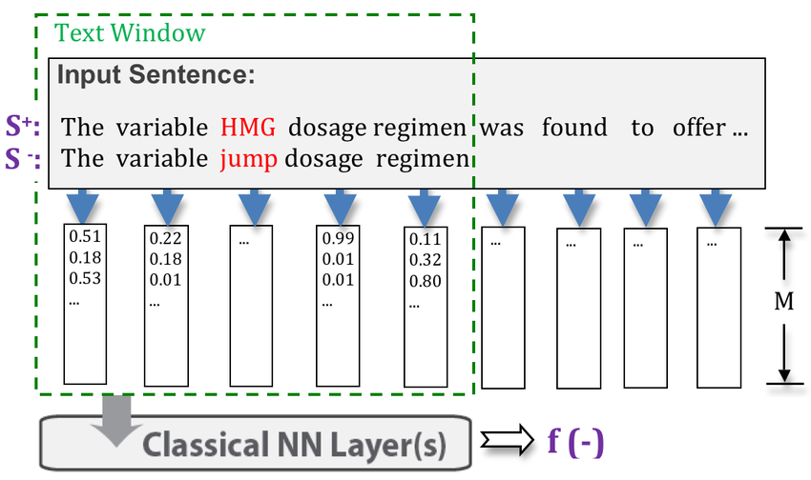
Segmentation Considerations
There are fields in NLP that require that the text be split on a per sentence / per paragraph level.
Word Embeddings (used in state-of-the-art AIs)

Slide 8
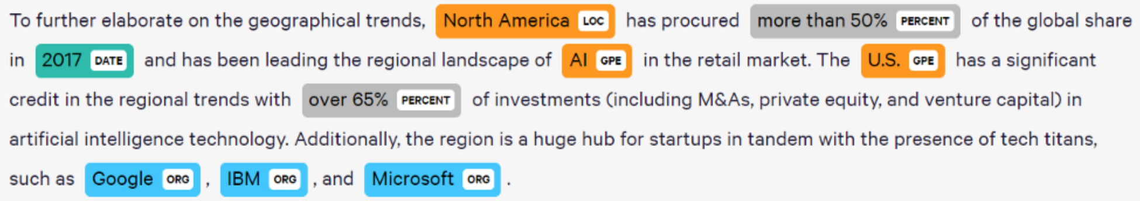
Segmentation Considerations
There are fields in NLP that require that the text be split on a per sentence / per paragraph level.
Named Entity Recognition (NER)

Slide 9
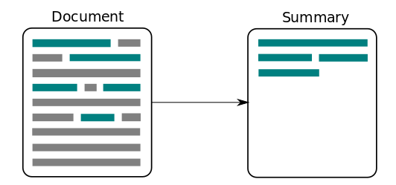
Segmentation Considerations
There are fields in NLP that require that the text be split on a per sentence / per paragraph level.
Summarization (Extractive and Abstractive)

Slide 10
Tokenization

Slide 11
Tokenization
Segmenting words in a text; transforming it into a consumable form.
Consumable = iterable of tokens
Done through RegEx

Slide 12
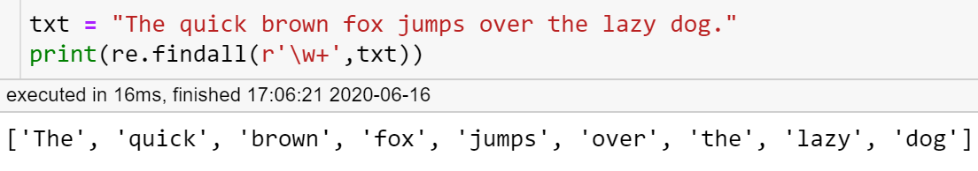
Tokenization
Segmenting words in a text; transforming it into a consumable form.
Consumable = iterable of tokens
Done through RegEx

Slide 13
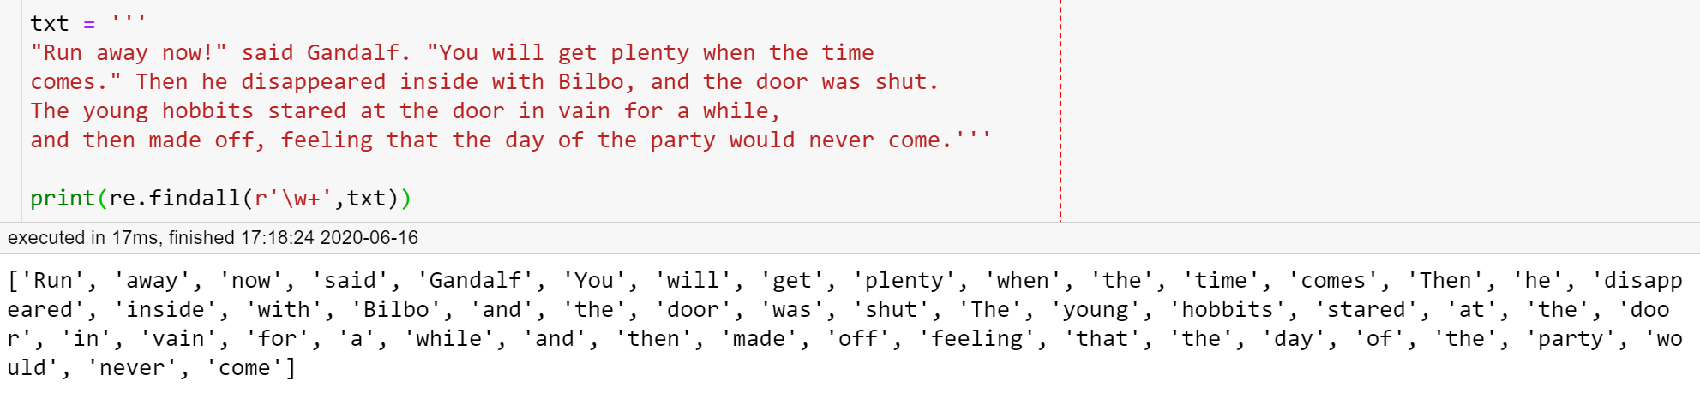
Tokenization Significance
Cleaning the text by removing characters / sequence of characters that don’t match the pattern of interest.
Note that sometimes punctuations are important (e.g. U.S.A.)

Slide 14
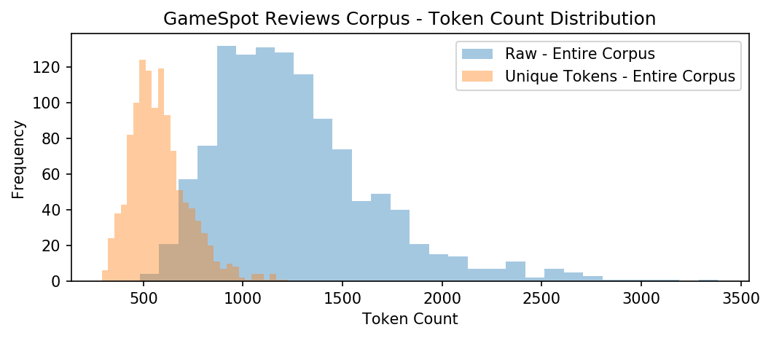
Tokenization Significance
Data Exploration - how many tokens / unique tokens does the document / corpus have?

Slide 15
Tokenization Significance
Majority have less than 1500 tokens.
Right tail (2000 tokens+)

Slide 16
Tokenization Significance
Typical review has around 500 unique tokens.
Median vocabulary size of critics.

Slide 17
Tokenization Significance
Will document length affect the performance
of down stream analytics?

Slide 18
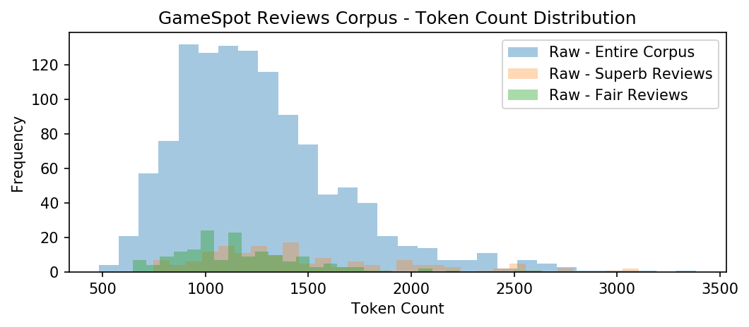
Tokenization Significance
Distribution Comparison
Across Different Labels

Slide 19
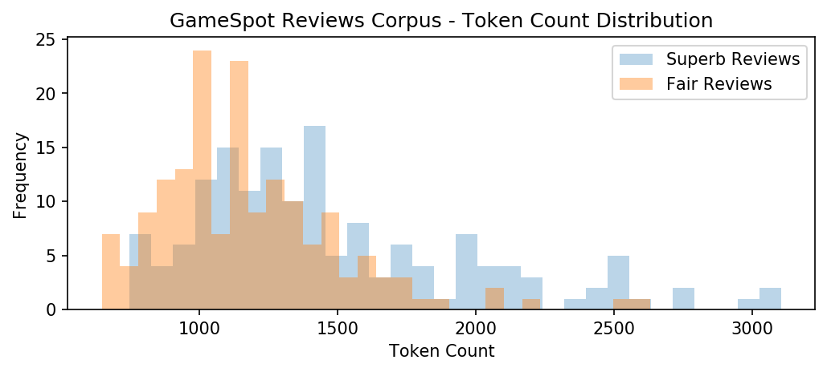
Tokenization Significance
Distribution Comparison
Across Different Labels

Slide 20
Tokenization Significance
Hypothesis Testing:
In the context of video games, good reviews
tend to be longer than bad reviews.

Slide 21
Tokenization Significance
Do people have more to say about
a good game vs a bad game?

Slide 22
Tokenization Significance
Could this be an issue when performing Sentiment Analysis?

Slide 23
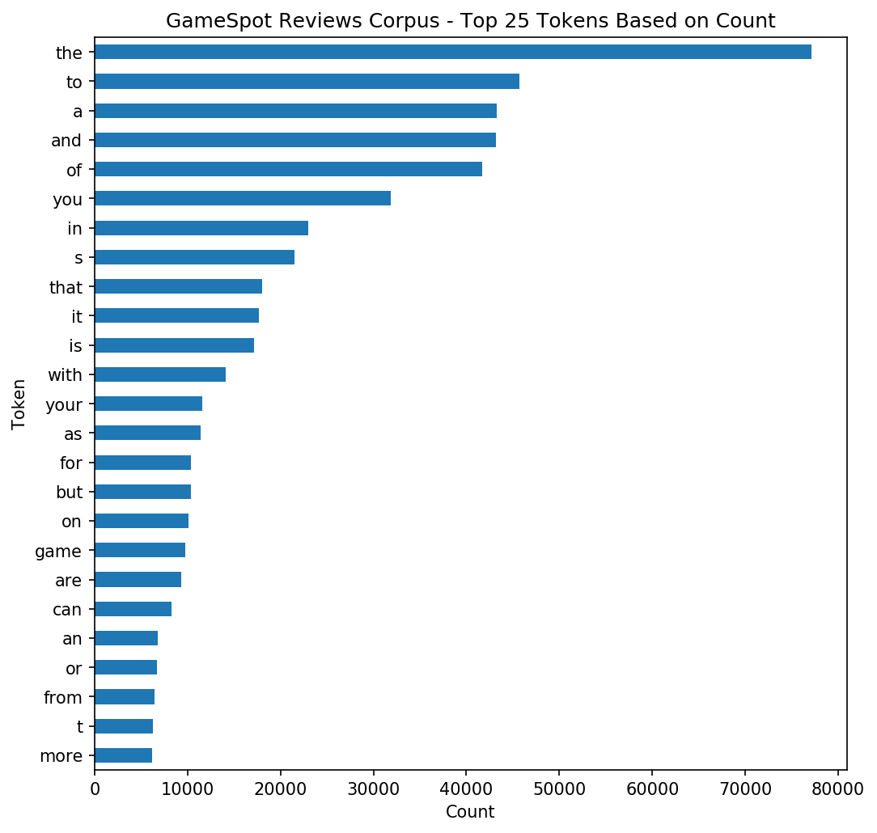
Tokenization Significance
Data Exploration - how many of each token does the document / corpus have?

Slide 24
Tokenization Significance
Zipf’s Law - power law distribution

Slide 25
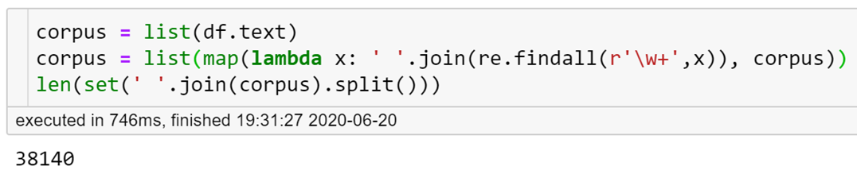
Tokenization Significance
No. of unique tokens (entire corpus)

Slide 26
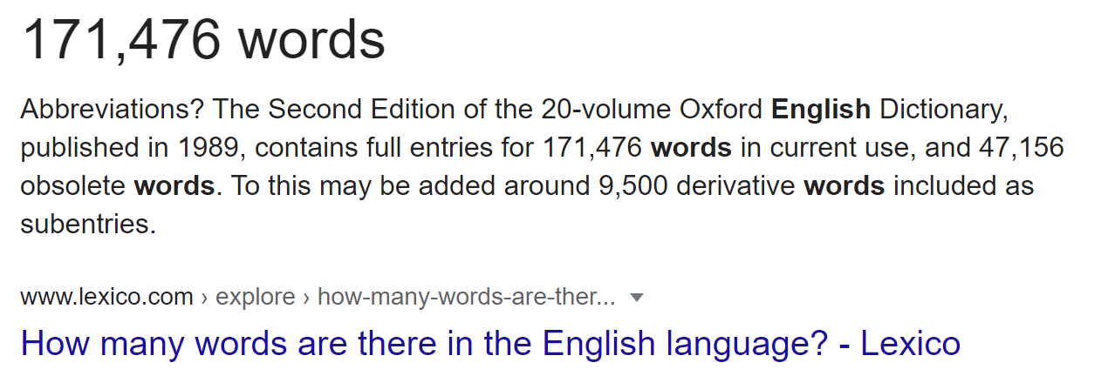
Tokenization Significance
No. of unique tokens (entire corpus)
No. of words in the English language

Slide 27
Tokenization Significance
There exist DOMAIN SPECIFIC
words that you won’t find anywhere else! (LOL, BRB, GG)
The “vocabulary” of your language model (Statistical / ML / AI) is dependent on the “vocabulary” of your dataset.

Slide 28
Tokenization Considerations
N-grams
New York → [New, York] (?) vs [New York] (?)
Contractions
who’ll, aren’t, don’t → who will, are not, do not
Hyphenated Compound Words and Dashes
mother-in-law → mother-in-law? mother in law (?)
You think she is a liar - she isn’t. → You think she is a liar she isn’t (?)

Slide 29
Tokenization Considerations
Concatenation
Lowercase → lowercase (?) lower case (?) lower-case (?)
Possessive
John’s paper → Johns paper (?) John paper (?) John’s paper (?)
Abbreviations
Mr. , Dr., PhD, U.S.A., LOL, DotA2 → _____

Slide 30
Reflection
We are now done with the first 2 most basic pipeline components.
We have already made “assumptions” in how we segment and tokenize the text.
We have already introduced ERRORS into the system.

Slide 31
Normalization

Slide 32
Normalization
Act of transforming tokens to a canonical form.
Reconcile words that have the same or similar meaning.
Reduces the number of unique tokens that you will process.

Slide 33
Normalization
Examples:
“The” vs “the”
“sleeping” vs “sleeps” vs “sleep”

Slide 34
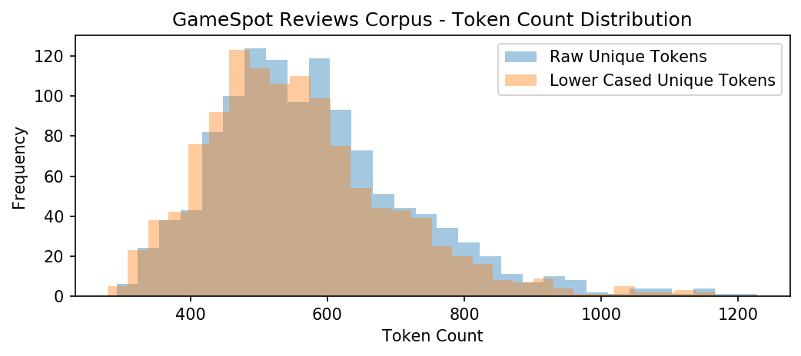
Normalization Case Folding
Lower casing the text since most of the letters are in lower case.
Language models are case sensitive.

Slide 35
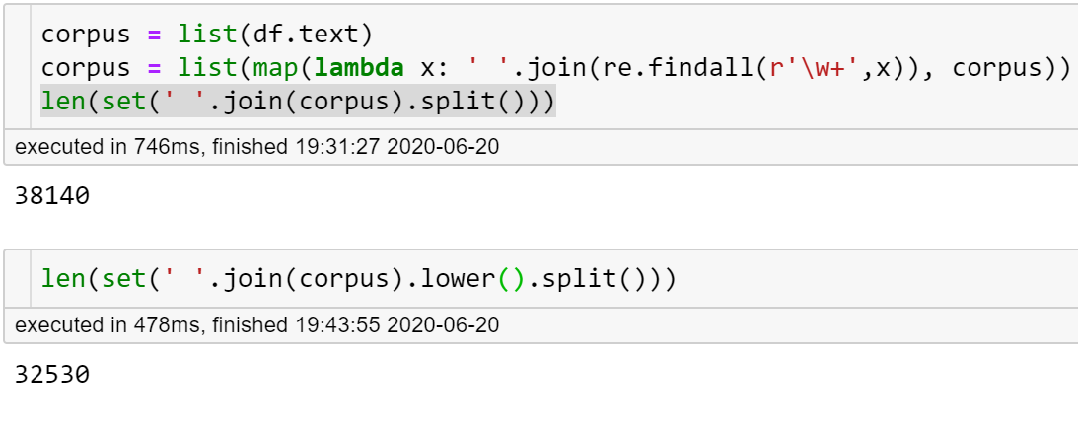
Normalization Case Folding
14.7% (5,610) reduction in number of unique tokens
Lower casing the text since most of the letters are in lower case.
Language models are case sensitive.

Slide 36
Normalization Case Folding
Sometimes casing is important.
“The US has a lot of COVID-19 deaths. I hope it doesn’t get worse.”
versus
“the us has a lot of covid-19 deaths. i hope it doesn’t get worse.”

Slide 37
Normalization Case Folding
Sometimes casing is important.
“The US has a lot of COVID-19 deaths. I hope it doesn’t get worse.”
versus
“the us has a lot of covid-19 deaths. i hope it doesn’t get worse.”
Could we lower case capital words in the middle of the sentence?

Slide 38
Normalization Stemming and Lemmatization
Morphemes
Small units of a word.
Words can always stand alone, morphemes can only stand alone if it is a root.
Stems – core unit that contains the meaning
e.g. running
Affixes – additional characters for grammatical purposes
e.g. running

Slide 39
Normalization Stemming and Lemmatization
Lemmatization
Transform different wordforms to its lemma.
Must find correct dictionary headword form (surrounding words as context)
providing, provided, provides → provide
Stemming
Chopping off of affixes

Slide 40
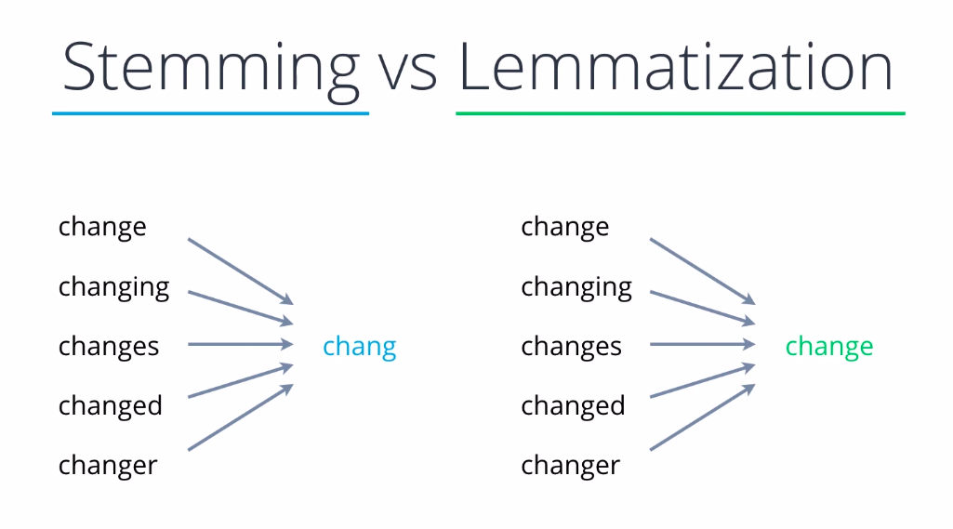
Normalization Stemming and Lemmatization
There are various Stemmers and Lemmatizers available.

Slide 41
Normalization Stemming and Lemmatization
Advantage of Stemming vs Lemmatization?

Slide 42
Words can have multiple definitions, and this can affect lemmatization.

Slide 43
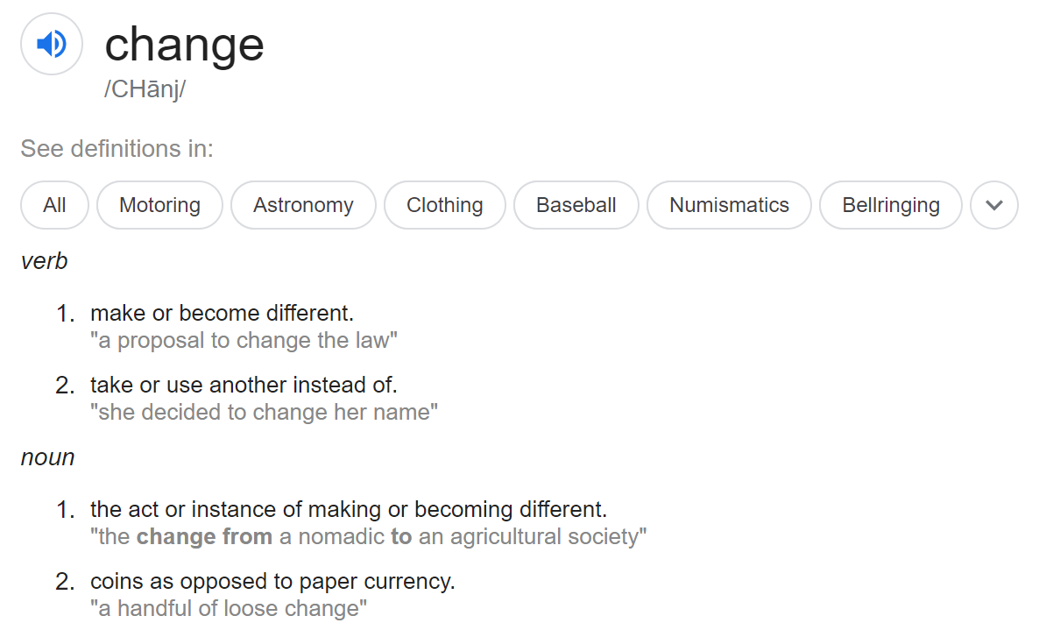

Slide 44
Different languages can have their own set of linguistic rules.
Chinese text have no space.
Japanese text mixes characters from different writing systems.
(e.g. Kanji, Kana, etc.)
German text have compound nouns.
(e.g. Flame Thrower = Flammenwerfer).

Slide 45
Hands On (work as a class)
Download the following dataset:
https://drive.google.com/file/d/1nUIasJCG4lKSMXi8THBIBHN5I7ZIJPcf/view?usp=sharing
Execute the pipeline on the first 50 documents. Use any NLP package.
Count the number of unique tokens before and after each pipeline component.
When is it good / bad to decrease the “vocabulary”?
Aren’t we technically loosing information? Is that good or bad?
NLTK
SpaCy
TextBlob
CoreNLP
polyglot
Pattern

Slide 46
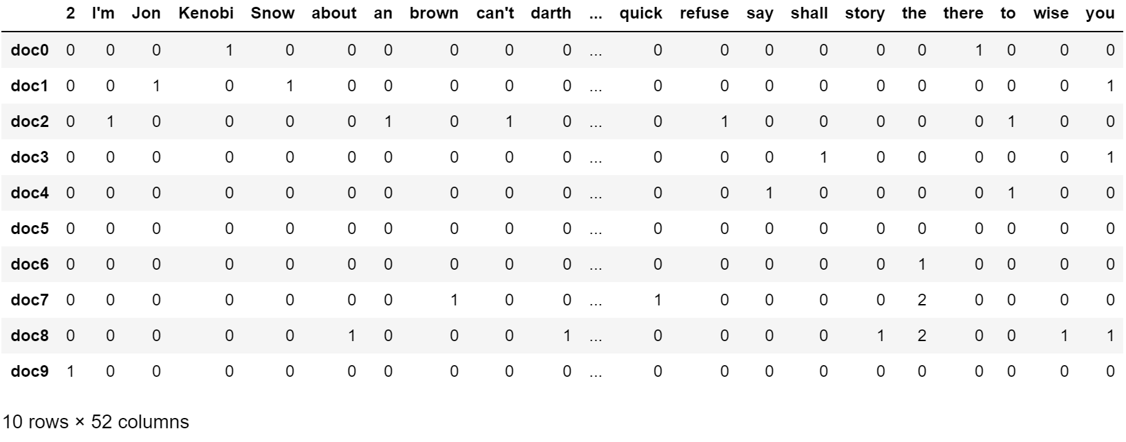
Bag Of Words Model
1 Row = 1 Document (variable length text)
1 Column = 1 Word (token)
Values = Frequency of the Word per Doc

Slide 47
Bag Of Words Model
What’s the problem here?

Slide 48
Bag Of Words
High Dimensional Sparse Matrix

Slide 49
Problems with Bag Of Words
Sparse: many zero entries.
Zeroes do not add information, and is expensive to store and process.
Somewhat remedied by storing only non-zero elements.

Slide 50
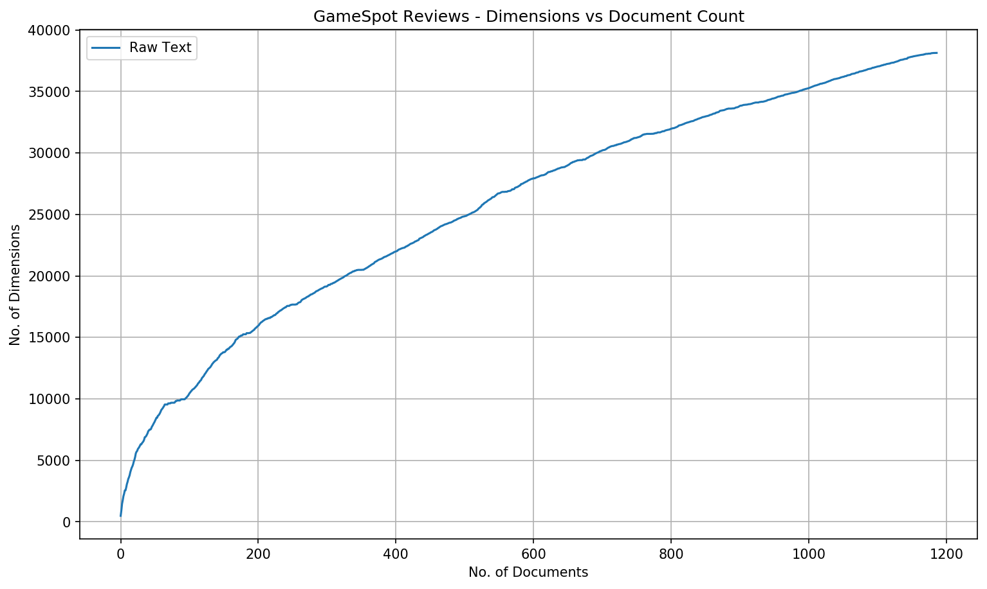
Problems with Bag Of Words
High Dimensional
Dimensions increases as you add more documents.

Slide 51
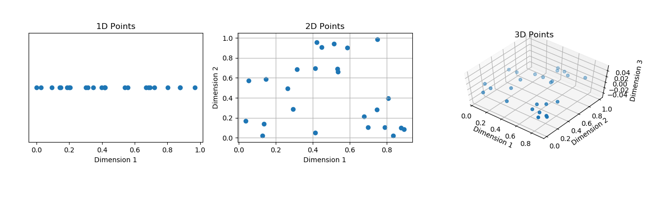
Problems with Bag Of Words
Curse of Dimensionality
The more dimensions you have, the more data you need to arrive at a statistically significant conclusion.

